Slide 1
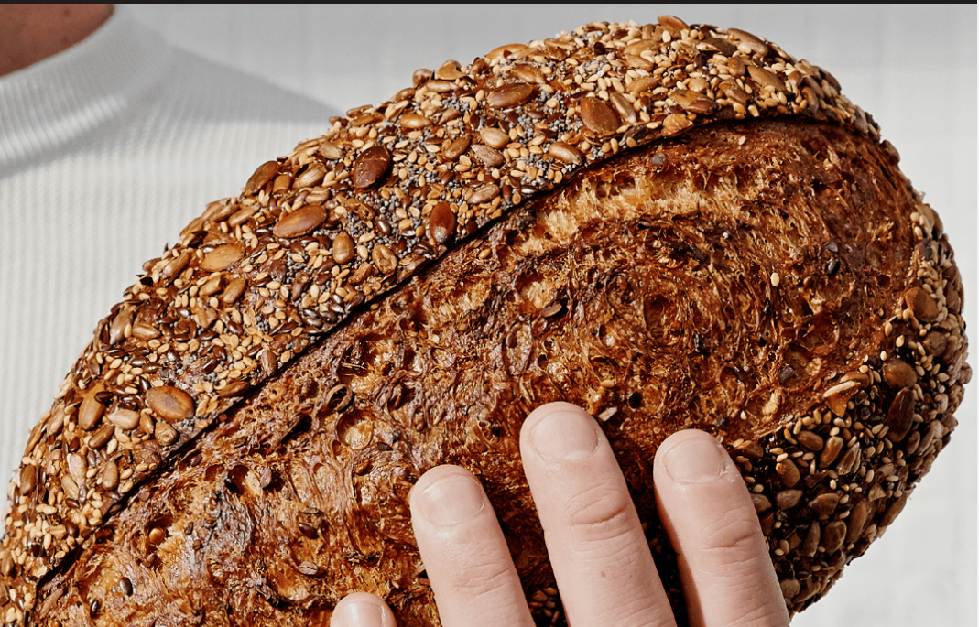

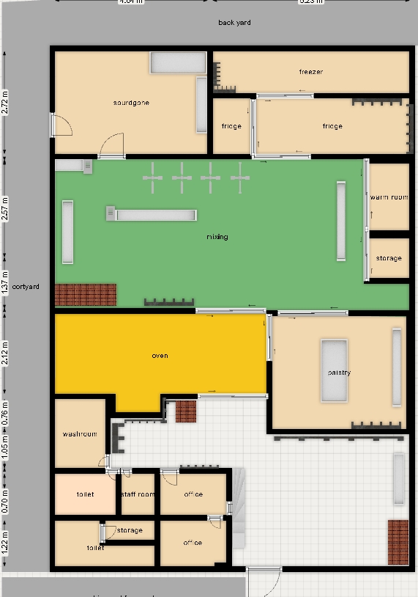

Slide 2
Sourdough
Walls
Racks
Floor
Clean wall with broom
Clean stains with wet towel
Clean racks with wet towel
Organize products
Clean tubs & lids with wet towel
Sweep floor with broom
Clean behind racks & machines

Slide 3
Sourdough
Blue wall
stoppers
Machine
Containers
Deep clean the machine accordingly manufacture instructions
Surface clean with towel
Sweep under with broom
Reorganize on place
Clean lids with towel
Clean with wet towel
Sweep under with broom

Slide 4
Sourdough
Products
Doors
Reorganize product to laybys
Check for any damages and report
Sweep doors with wet towel
Check for any damages and report

Slide 5
Mixing
Walls
Machine
Mixers
Clean wall with broom
Clean stains with wet towel
Deep clean the machine accordingly manufacture instructions
Surface clean with towel
Sweep under with broom
Deep clean the machine accordingly manufacture instructions
Surface clean with towel
Sweep under with broom

Slide 6
Mixing
Blue wall
stoppers
Racks
Floor
Clean racks with wet towel
Organize products
Clean tubs & lids with wet towel
Sweep floor with broom
Clean behind racks & machines
Clean with wet towel
Sweep under with broom

Slide 7
Mixing
Door Handles
Doors
Sink
Clean doors handles with wet towel
Check for any damages and report
Sweep doors with wet towel
Check for any damages and report
Bleach the sink and let it sits for 5 mins
Drain sink and clean
Clean surface

Slide 8
Mixing
pallets &
Racks
Ovens
Table
Deep clean the machine accordingly manufacture instructions
Surface clean with towel
Sweep under with broom
Sweep the table and clean with wet towel
Organize second level
Leave tidy and clean
Organize products
Clean tubs & lids with wet towel
Move products from pallets to racks
Clean racks with wet towel

Slide 9
Mixing
Sink
Floor space
Bleach the sink and let it sits for 5 mins
Drain sink and clean
Clean surface
Sweep floor with broom
Clean with the machine
Clean behind racks & machines
Leave nice and tidy

Slide 10
Pastry
Table
Ovens
Racks
Sweep the table and clean with wet towel
Organize second level
Leave tidy and clean
Deep clean the machine accordingly manufacture instructions
Surface clean with towel
Sweep under with broom
Clean racks with wet towel
Organize products
Clean tubs & lids with wet towel

Slide 11
Pastry
Blue wall
stoppers
Floor
Doors
Sweep floor with broom
Clean behind racks & machines
Clean with wet towel
Sweep under with broom
Sweep doors with wet towel
Check for any damages and report

Slide 12
Pastry
Door Handles
Machine
Trays
Clean doors handles with wet towel
Check for any damages and report
Deep clean the machine accordingly manufacture instructions
Surface clean with towel
Sweep under with broom
Scrape trays and send to cleaning
Clean trolly

Slide 13
Ovens
Ovens
Table
Floor
Deep clean the machine accordingly manufacture instructions
Surface clean with towel
Sweep under with broom
Sweep the table and clean with wet towel
Organize second level
Leave tidy and clean
Sweep floor with broom
Clean behind racks & machines

Slide 14
Dishwasher Room
Sinks
Dishwasher
Floor
Bleach the sink and let it sits for 5 mins
Drain sink and clean
Clean surface
Drain dishwasher, fill with water and bleach and let it sit
Surface clean with towel
Take sponge and clean the inside
Sweep floor with mop
Clean behind racks & machines
Clean floor with machine

Slide 15
Dishwasher Room
Floor Cleaner
Machine
Racks
Tray cleaner
Clean racks with bleach
Organize according the laybys
Deep clean the machine accordingly manufacture instructions
Surface clean with towel
Sweep under with broom
Deep clean the machine accordingly manufacture instructions
Surface clean with towel

Slide 16
Staff Room
Sink
Fridge
Floor
Bleach the sink and let it sits for 5 mins
Drain sink and clean
Clean surface
Throw old products
Clean fridge
Sweep floor with mop
Clean behind racks & machines
Clean floor with machine

Slide 17
Staff Room
Lockers
Table
Sweep the lockers with wet towel
Leave tidy and clean
Sweep the table and clean with wet towel

Slide 18
Main Hall
Products Racks
Printer rack
Clean racks with wet towel
Organize products
Clean tubs & lids with wet towel
Clean racks with wet towel
Organize products
Leave place tidy and liable

Slide 19
Main Hall
Organize crates
Floor
Clean moving space
Put in storage unused crates
Sweep floor with broom
Clean behind racks & machines
Clean floor with machine

Slide 20
Main Hall
Table
Machine
Sweep the table and clean with wet towel
Leave the table tidy
Deep clean the machine accordingly manufacture instructions
Surface clean with towel
Sweep under with broom

Slide 21
Toilet
Toilet
Storage
Floor
Clean toilet
Refill toilet paper
Clean sink + mirror
Restock the storage
Tidy up the cabinet
Clean floor with mop

Slide 22
Office
Toilet
Tables
Floor
Clean toilet
Refill toilet paper
Clean sink + mirror
Sweep the table and clean with wet towel
Leave the table tidy
Vacuum the floor

Slide 23
Office
whiteboard
Stationary
Erase the old tasks
Create new one for the week
Refill stationary
Tidy up the station

